Slide 1

Week 3 (Tue): Historical Scots Myth 3: Scots is used by uneducated people
/joanːa koˈpaʧɪk/
Joanna Kopaczyk
joanna.kopaczyk@glasgow.ac.uk
Drop-in hours: Tue 4pm-5pm
ENGLANG1003
English Language and Linguistics 1B: Language, Society and Change

Slide 2
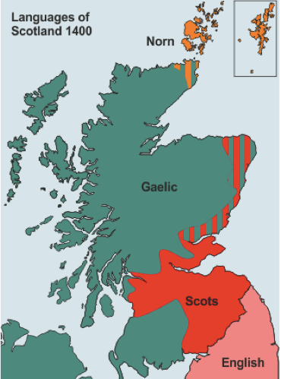
Above the Solway Firth – Tyne line
Gaelic = the language of the Scoti (the Celtic-speaking Scottish kingdom)
“Scottis”
northern Germanic dialects (Anglian / Old Northumbrian) across the two kingdoms
Inglis
Englishe

Slide 3
‘Inglis’ as referring to Scots
Off Langagis in Bretayne sere
I fynd that sum tym fyff thare were:
Off Brettys fyrst, and Inglis syne,
Peycht, and Scot, and syne Latyne.
The Orygynale Cronykil of Scotland, by Androw of Wyntoun (c.1420), ll.1373-1376
cf. McClure 1981
Notes:
1) What does the term ‘Inglis’ mean?
From the beginning of the extant records in the medieval Scottish vernacular, this is the label used to refer to that language
as in this quotation from Androw of Wyntoun’s Chronicle:
2) where we read about the language of the Britons, the language of the Inglis, Picts, Scots – so the Gaelic-speaking population, and Latin.
3) Note that the English of the south and Inglis of the north would be mutually intelligible in the l.14th c. – hence the common label for both.

Slide 4
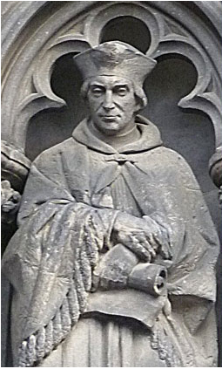
‘Scottis’ as referring to Scots
HEYR BEGYNNYS THE WARK OF VIRGYLL PRYNCE OF LATYN POETIS IN HYS TWELF BUKIS OF ENEADOS COMPILIT AND TRANSLATIT FURTH OF LATYN IN OUR SCOTTIS LANGAGE BY ANE RIGHT NOBILL AND WIRSCHIPFULL CLERK MASTER GAWYN DOWGLAS...
[...]
Lyke as in Latyn beyn Grew termys ſum,
So me behufyt quhilum, or than be dum,
Sum baſtard Latyn, Franch, or Inglys oys,
Quhar ſcant was Scottis, I had nane other choys.
The Aeneid, Prologue, ll.3-6
Gavin Douglas (1513)
Sudroun in the south!
The first translation of Virgil’s Eneados into any Germanic language!
Notes:
But with the growing separate Scottish identity, there was a need to appropriate a label which would distinguish the language of Scotland from its relative in the South.
This early 16th c. quotation is one of the earliest employments of ‘Scottis’ in this sense: it’s the title page from Gavin Douglas’s translation of the Aeneid, and the same term is used in the text where he apologizes for sprinkling his text with borrowings where ‘Scottis’ lacks appropriate terms.

Slide 5
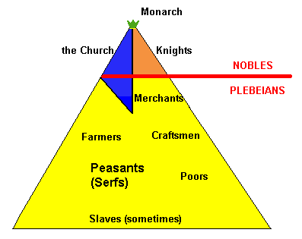
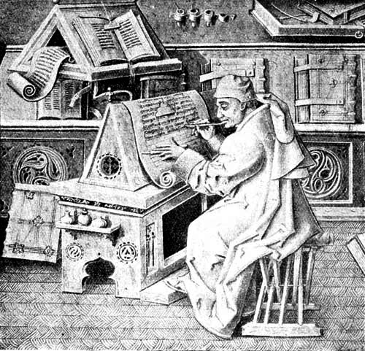
Whose language survives in historical record?
Literacy?
It’s all in Latin anyway!
Social strata in early medieval Europe
https://pages.uoregon.edu/klio/wc07/21-earlymed.html

Slide 6
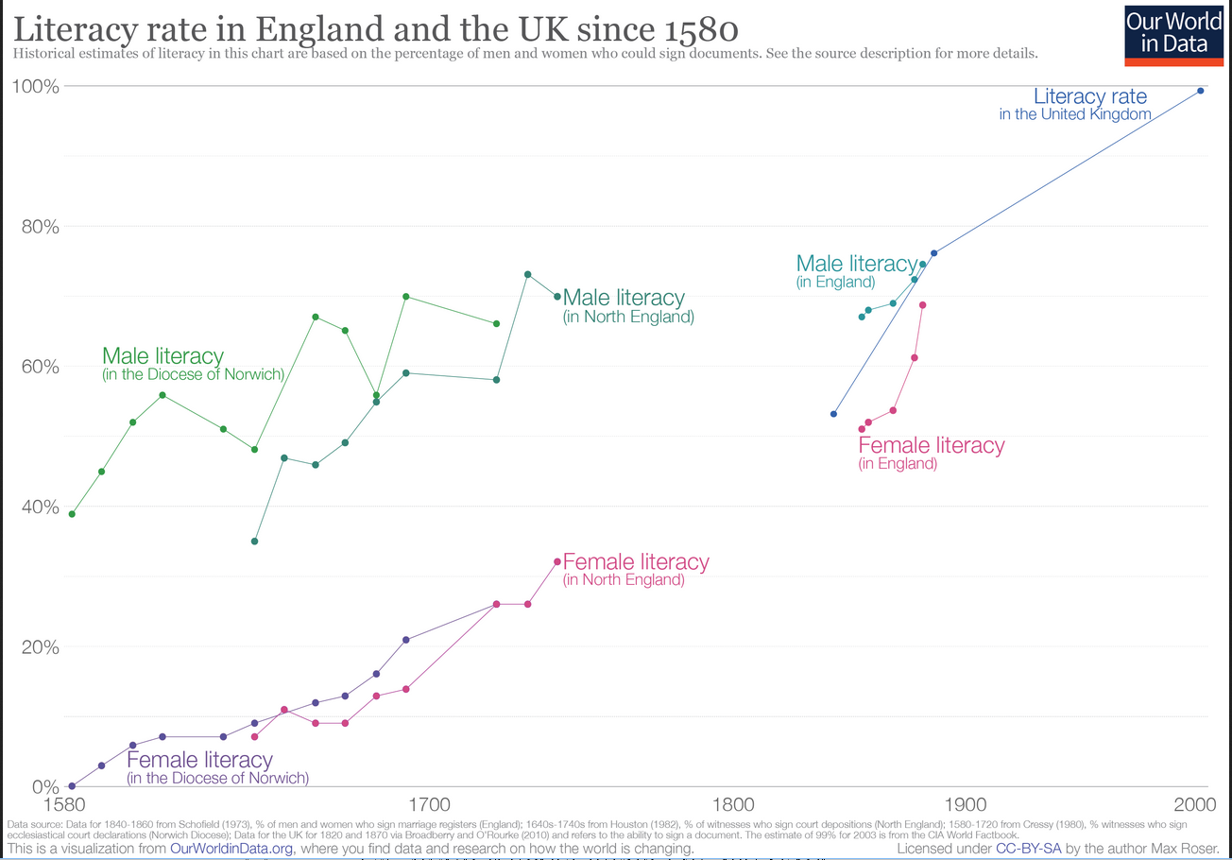
cf. the rise of literacy in Scotland on the National Lbrary of Scotland webpage

Slide 7
To bear in mind
The texts surviving in manuscripts and early prints pre-1700 reflect language use of the best educated and most influential sectors of the society.
Today’s focus:
Scots as the language of aristocracy and courtly entertainment

Slide 8
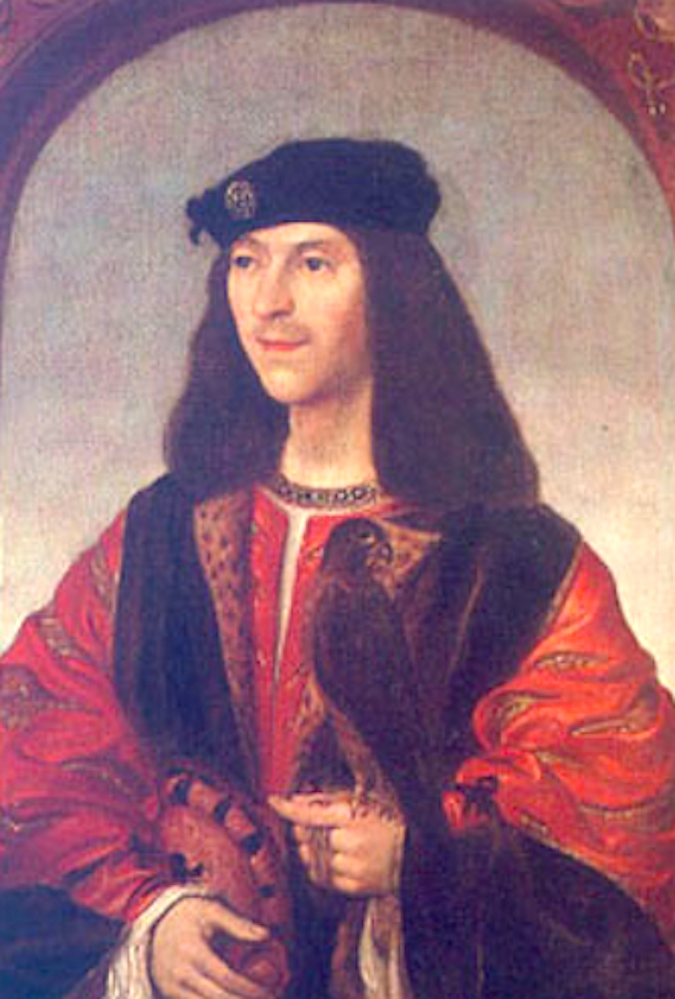
The Flyting of Dunbar and Kennedy
William Dunbar (1460?-1513?/1530?)
Walter Kennedy (1455?-1518?)
c.1490-1501
may have been performed at the court of James IV
survives in Chepman and Myllar prints from 1508 – one of the earliest printed texts in Scotland
James IV
1488-1513
(National Gallery of Scotland)
‘an exercise in vituperatio … a full-scale competitive exchange of insults’ (Burrow 2006: 142)

Slide 9
Kennedy’s opening challenge (fragment, ll.25-40)
Dirtin dumbar, quhome on blawis thow thy boist,
Pretendand the to wryte sic skaldit skrowis?
Ramowd rebald, thow fall doun att the roist
My laureat lettres at the and I lowis:
Mandrag, mymmerkin, maid maister bot in mows,
Thrys scheild trumpir with ane threid bair goun,
Say Deo mercy, or I cry the doun,
And leif thy ryming, rebald, and thy rowis.
Dreid, dirtfast dearch, that thow hes dissobeyit
My cousing Quintene and my commissar;
Fantastik fule, trest weill thow salbe fleyit;
Ignorant elf, aip, owll irregular,
Skaldit skaitbird and commoun skamelar,
Wan fukkit funling that natour maid ane yrle—
Baith Johine the Ros and thow sail squeill and skirle
And evir I heir ocht of ȝour making mair.
notice diagnostic variants in spelling, grammar and vocabulary!

Slide 10
Dunbar’s opening challenge (fragment, ll.49-64)
Iersche brybour baird wyle beggar with thy brattis Cuntbittin crawdoun kennedy coward of kynd Evill farit and dryit as denseman on ye rattis Lyk as the gleddis had on thy gulesnowt dynd Mismaid monstour ilk mone owt of thy mynd Renunce rebald thy rymyng thow bot royis Thy trechour tung hes tane ane heland strynd Ane lawland ers wald mak a bettir noyis.
Revin, raggit ruke, and full of rebaldrie,
Scarth fra scorpione, scaldit in scurrilitie,
I se the haltane in thy harlotrie
And in to uthir science no thing slie,
Of every vertew void, as men may sie;
Quytclame clergie and cleik to the ane club,
Ane baird blasphemar in brybrie ay to be;
For wit and woisdome ane wisp fra the may rub.
notice diagnostic variants in spelling, grammar and vocabulary!

Slide 11
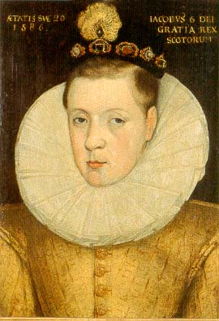
James VI (1567-1625)
The Flyting of Montgomerie and Polwart
(circa 1585, JVI’s court)
P:
Thy raggit roundaillis, reifand royt,
Sum schort, sum lang and out of lyne
With skabrous collouris, fowsome floyt
Proceiding from ane pynt of wyne...
portrait by unknown artist, 1586
(to be seen in Falkland Palace in Fife)
M:
Fonnd flytter, scheitt schytter, baccoun bytter, befyld! blunt bleitter, padok speitter, pudding eitter, perverss! hen pluker, closet muker, hous cukker, vere vyld! Tanny cheikis, I think þow speikis with thy breikis, foul erss! Woodelyk hudepyk, ay lyk to live in lak! flour þe pin, scabbit skin! eit it in þat þow spak.
Notes:
just as an example ☺
but we already recognise some offensive language we saw in the court records – but this time it’s recognised as playful and not harmful to reputation
In order to harm reputation and provoke a reply, attacks on the poetic skill > see some examples

Slide 12
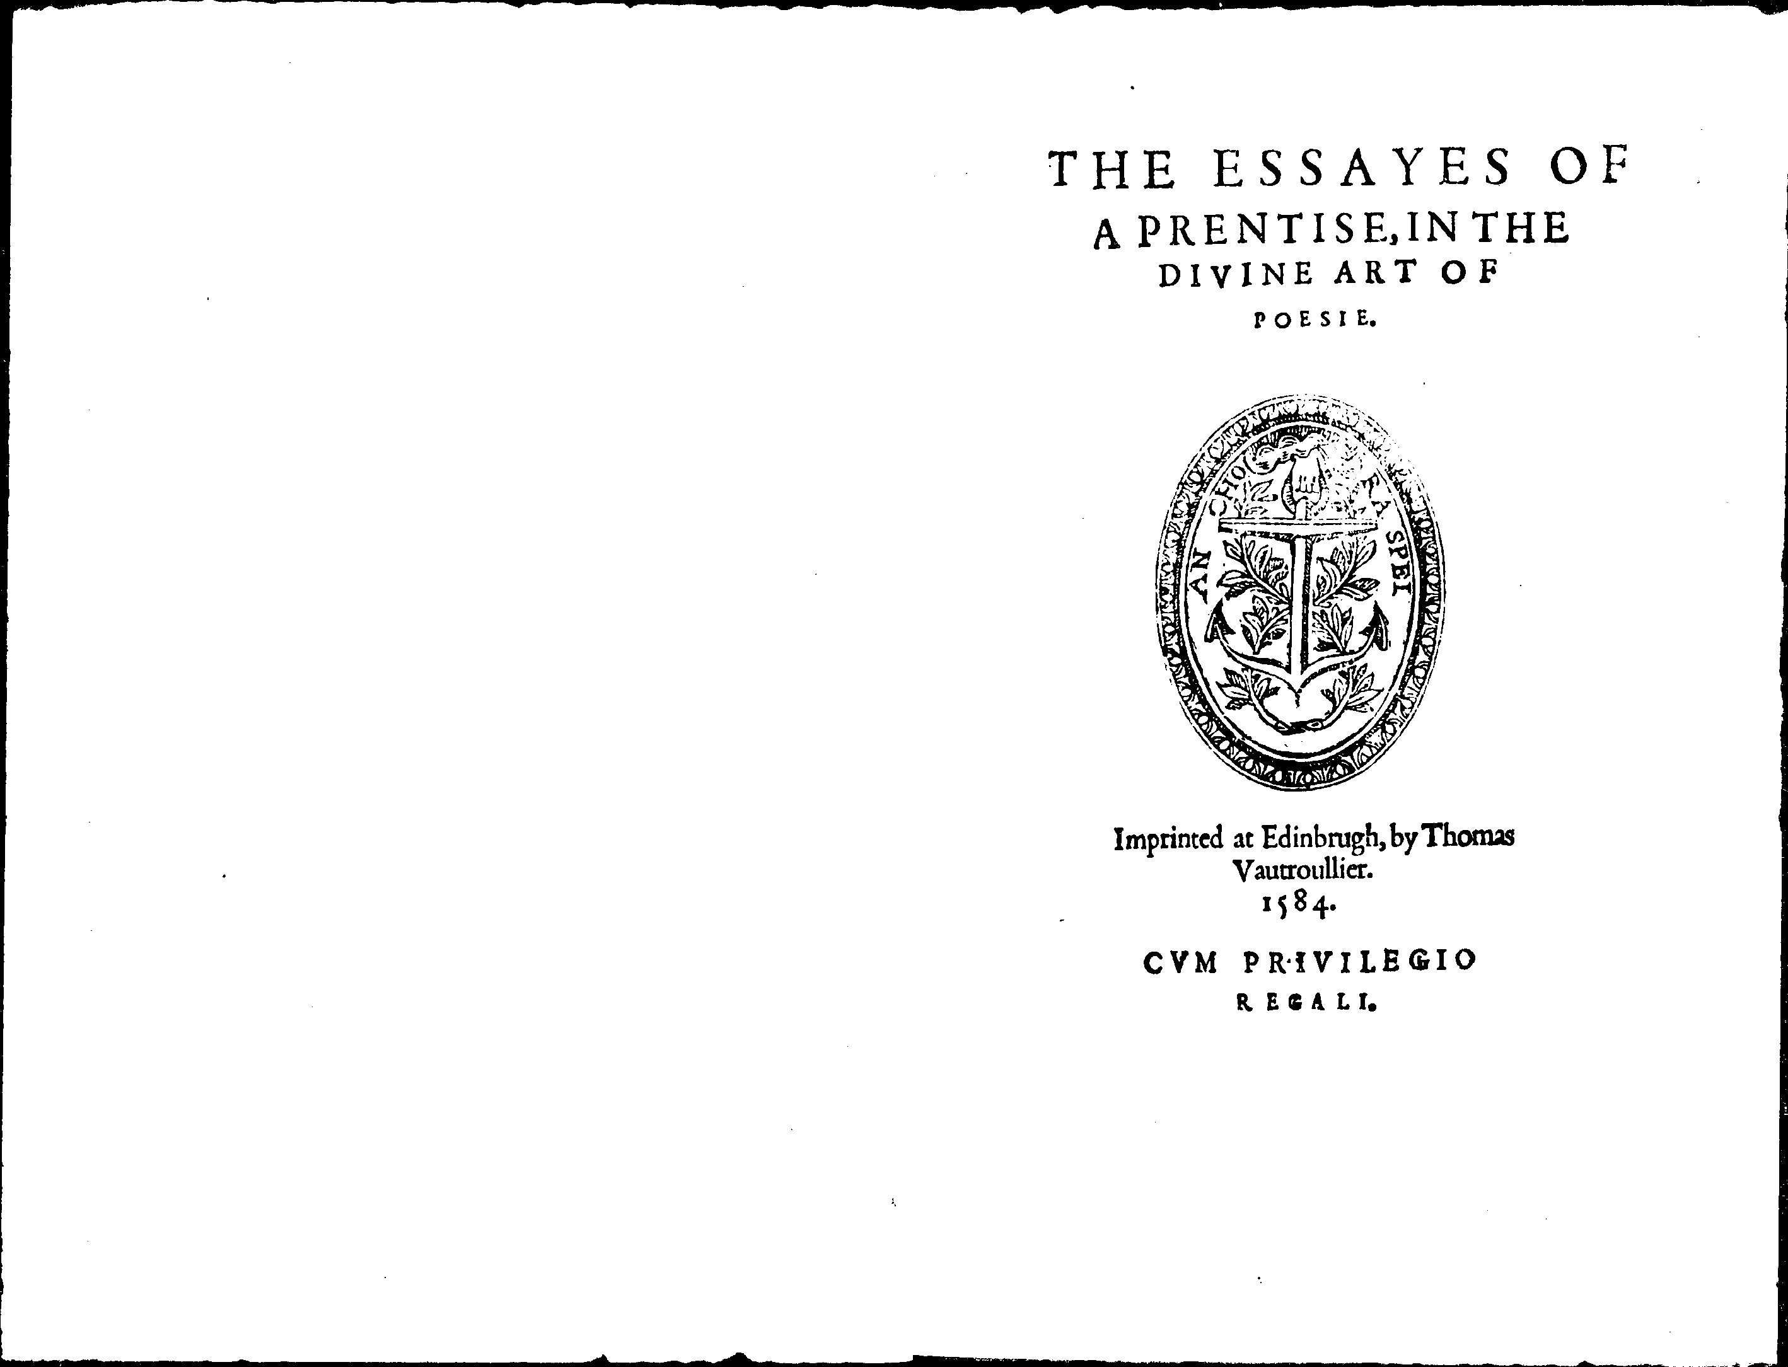
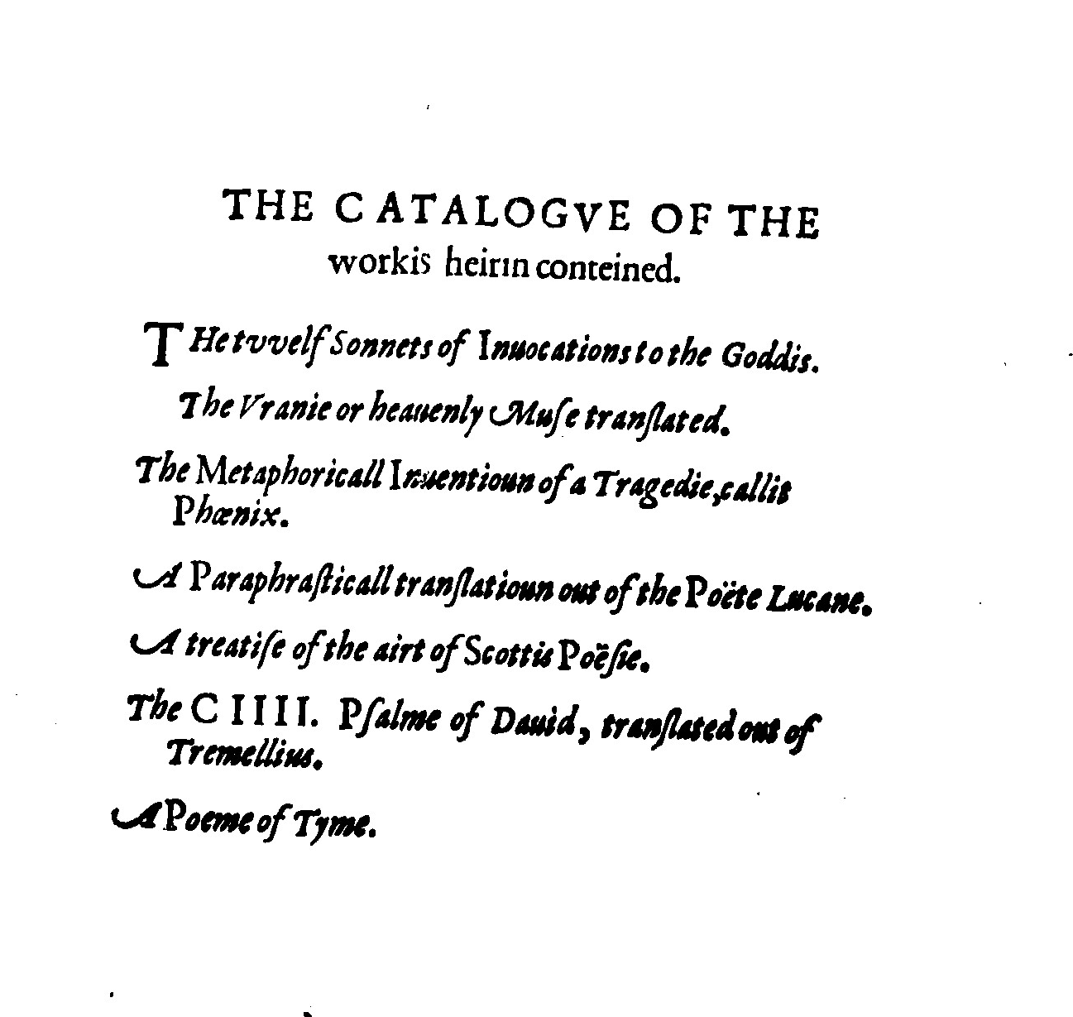
James VI (1584)
Ane Schort Treatise Conteining some Revlis and Cautelis to be obseruit and eschewit in Scottis Poesie
Notes:
James wanted to refashion Scottish literary production under his own guidance (and patronage)
The Essayis, for all their occasional naiveté as literary criticism, are a bid by James for credibility as head of a courtly renaissance; they were thus a significant component in his self-fashioning as a new kind of ruler for Scotland, comparable to other contemporary humanist magnates.
The book was also a political statement – a French printer who was a religious exile, first in London, then also opened business in Edinburgh

Slide 13
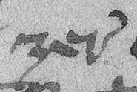
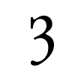
James VI’ view on writing in Scots
James VI: Ane Schort Treatise Conteining some Revlis and Cautelis to be obseruit and eschewit in Scottis Poesie (1584)
For albeit sindrie hes written of it in English, quhilk is lykest to our language [emphasis added], zit we differ from thame in sindrie reulis of Poesie, as ze will find be experience.
“Albeit many have written about it [poetry] in English, which is most similar to our language, yet we differ from them in many rules of poetry, as you will find by experience”
z
yogh
ʒer^{e} ‘year’
zere
‘year’
Notes:
He also finds that the world is changing and has changed and that the old rules of poetry may not be valid anymore.

Slide 14
James VI: Ane Schort Treatise Conteining some Revlis and Cautelis to be obseruit and eschewit in Scottis Poesie (1584)
On the choice of words
find your diagnostic variants!
= ‘you must’
= ‘you choose’
Ze man lykewayis tak heid, that ze waill zour wordis according to the purpose: As, in ane heich and learnit purpose, to vse heich, pithie, and learnit wordis.
Gif zour purpose be of loue, To vse commoun language, with some passionate wordis.
Gif zour purpose be of tragicall materis, To use lamentable wordis, with some heich, as rauishit in admiratioun.
Gif zour purpose be of landwart effairis, To vse corruptit, and vplandis wordis.
And finally, quhatsumeuer be zour subiect, to vse vocabula artis, quhairby ze may the mair viuelie represent that person, quhais pairt ze paint out.
Notes:
Vplandis wordis – uncouth, unsophisticated, from the countryside > so dialectal words for topics to do with country living

Slide 15
James VI: Ane Schort Treatise Conteining some Revlis and Cautelis to be obseruit and eschewit in Scottis Poesie (1584)
On alliteration
Let all zour verse be Literall, sa far as may be, quhatsumeuer kynde thay be of, bot speciallie Tumbling verse for flyting. By Literall I meane, that the maist pairt of zour lyne, sall rynne vpon a letter, as this tumbling lyne rynnis vpon F.
Fetching fude for to feid it fast furth of the Farie.

Slide 16
James VI: Ane Schort Treatise Conteining some Revlis and Cautelis to be obseruit and eschewit in Scottis Poesie (1584)
On poetic form
For compendious praysing of any bukes, or the authouris thairof, or ony argumentis of vther historeis, quhair sindrie sentences, and change of purposis are requyrit, vse Sonet verse, of fourtene lynis, and ten fete in euery lyne.

Slide 17
James VI: Ane Schort Treatise Conteining some Revlis and Cautelis to be obseruit and eschewit in Scottis Poesie (1584)
Lyke verse of ten fete, ... ze may vse lykewayis in loue materis: as also of all kyndis of cuttit and brokin verse, quhairof new formes are daylie inuentit according to the Poetis pleasour, as ...
Lo! hovv that lytill God of loue
Before me then appeard,
So myld-lyke
And chyld-lyke
VVith bovv thre quarters skant
So moylie
And coylie
He luckit lyke a Sant.
Notes:
The expression moylie and coylie ‘meekly and coyly’ might be an example of James’s liking for proverbial sayings, as witnessed in his letters; the form moylie (derived according to OED from Middle Dutch) seems to be a Scottish/Northern English expression

Slide 18
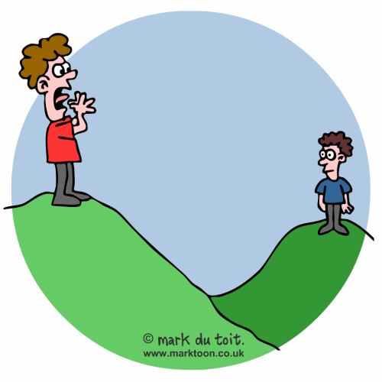
James VI: Ane Schort Treatise Conteining some Revlis and Cautelis to be obseruit and eschewit in Scottis Poesie (1584)
“Ze man also take heid to frame zour wordis and sentencis according to the mater: As in Flyting and Inuectiues, zour wordis to be cuttit short, and hurland ouer heuch.”
“For flyting, or Inuectiues, vse ... Rouncefallis or Tumbling verse.”

Slide 19
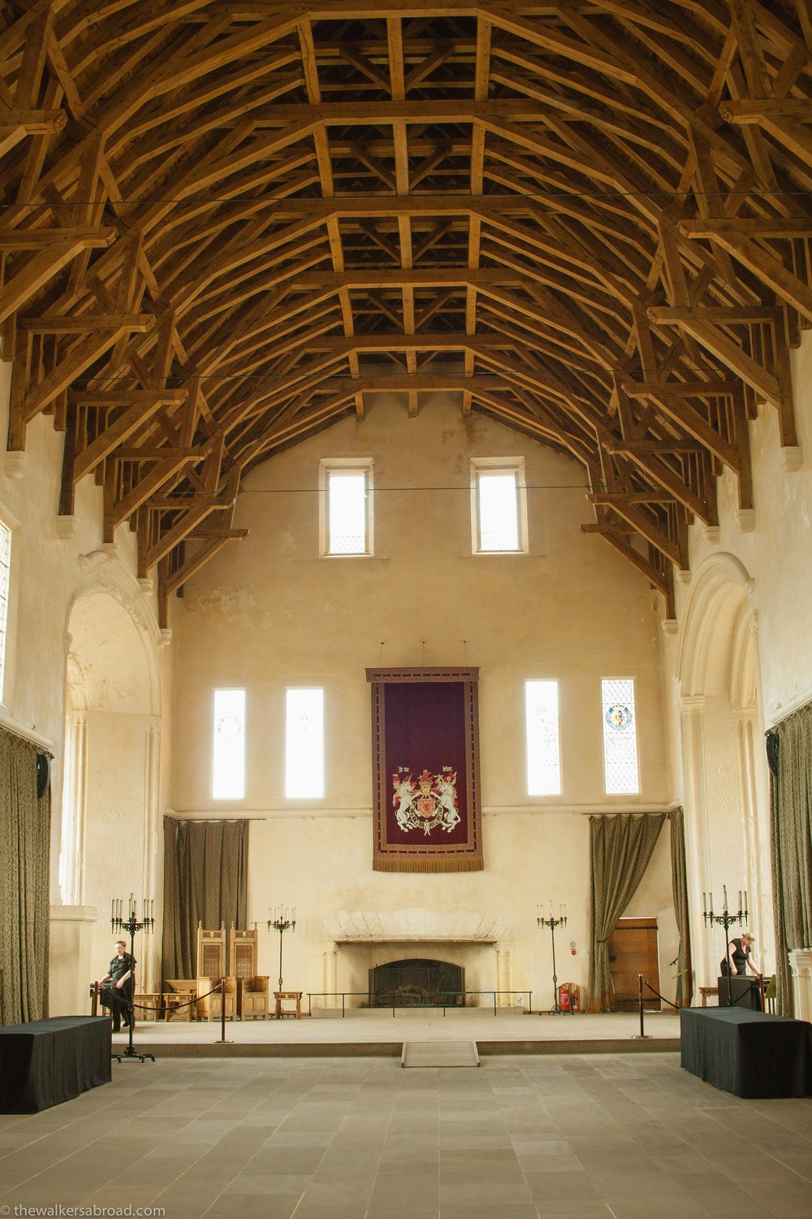
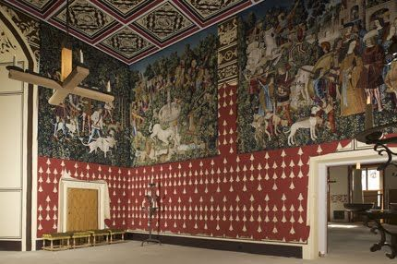
“Allusions in the poems of Montgomerie, Polwart, and James VI suggest that verse flyting was carried on in public, on winter nights, in the presence of one's opponent and the king” (Bawcutt 1992: 233)
Stirling Castle
The Great Hall
Holyrood Palace

Slide 20
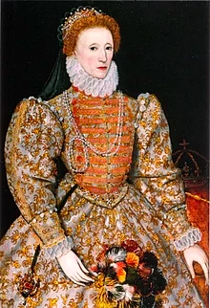
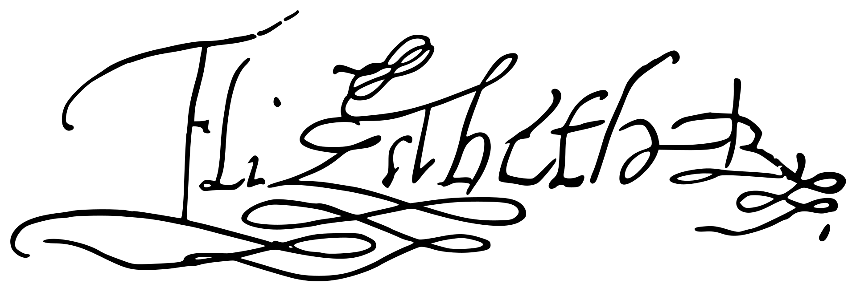
“She possessed nine languages so thoroughly that each appeared to be her native tongue...”
Giovanni C. Scaramelli
Venetian Ambassador
(7 April 1603)
English
Welsh
Cornish
Irish
Scots
Latin
French
Spanish
Italian
1558-1603
Notes:
She possessed nine languages so thoroughly that each appeared to be her native tongue; five of these were the languages of peoples governed by her, English, Welsh, Cornish, Scottish, for that part of her possessions where they are still savage, and Irish. All of them are so different, that it is impossible for those who speak the one to understand any of the others. Besides this, she spoke perfectly Latin, French, Spanish, and Italian extremely well.
Giovanni Carlo Scaramelli, Venetian Ambassador in England, to the Doge and Senate. (7 April 1603)
'Venice: April 1603', in Calendar of State Papers Relating To English Affairs in the Archives of Venice, Volume 9, 1592-1603, ed. Horatio F Brown (London, 1897), pp. 562-570. British History Online http://www.british-history.ac.uk/cal-state-papers/venice/vol9/pp562-570 [accessed 17 February 2019].

Slide 21
To recap:
the Scots language was used across all social strata in medieval and early modern Scotland
Scots was recognised internationally as different from English
REMEMBER: before 17c the upper classes did not have English – their language was Scots
in fact, the surviving textual material was written by the best educated people (clerks, scribes, poets, etc.) and gives us more information about the language of the higher strata
glimpses of ‘street talk’ in courtly entertainment

